Slide 1

NYC taxi trip duration
Analysis and Prediction
DOMAIN: Transportation
By: Gaurav Padawe

Slide 2

Presentation Outline
Business Objective
Data Source
Methodology
Evaluation
Summary

Slide 3

Business Objective
Build a model that predicts the total trip
duration of taxi trips in New York City.

Slide 4

Data Source:
Source: NYC Taxi and Limousine Commission (TLC) and Kaggle
Statistics:
Rows - 1458644
Features - 11 (Including Target)
Target – Trip Duration

Slide 5
Questions Arising
What types of Variables do we have ?
Are there any False trips or Invalid data point which exceeds Trip Duration well above impossibility ?
What’s the most frequent travelled destination ?
And much more to know as we continue with Analysis.

Slide 6

Methodology

Slide 7

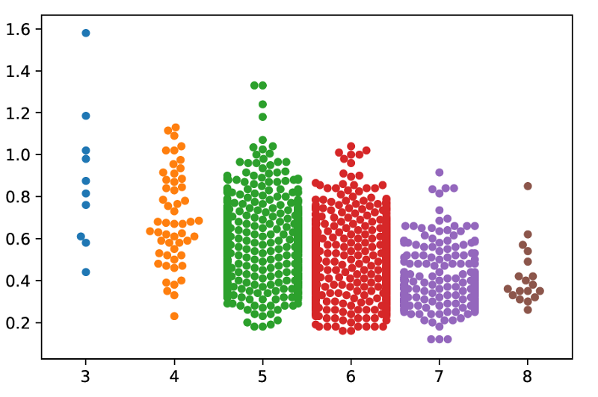

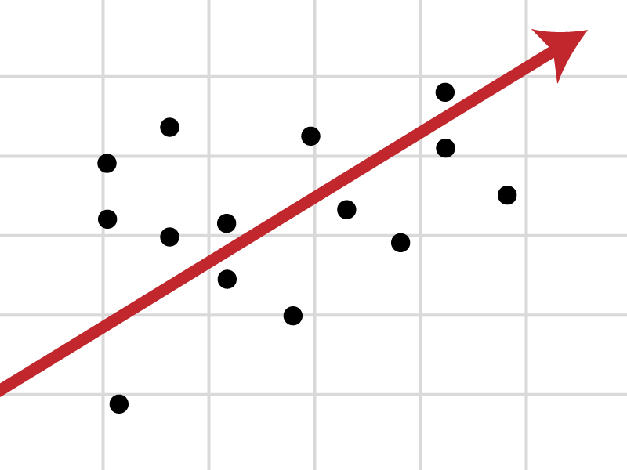
Approach
Data Preparation
and
Exploratory Data Analysis
Building Predictive Model
using Multiple
Techniques / Algorithms
Optimal Model Identified
through
Testing and Evaluation

Slide 8
Machine Learning Algorithm
Decomposition : PCA
Linear Regression
Decision Tree
Random Forest
Tools Used
Jupyter Notebook(Python)
Tableau
Google Collab Research

Slide 9
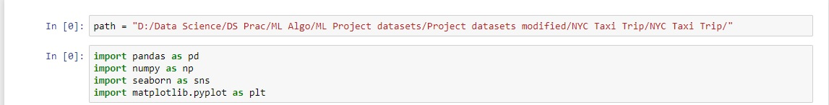
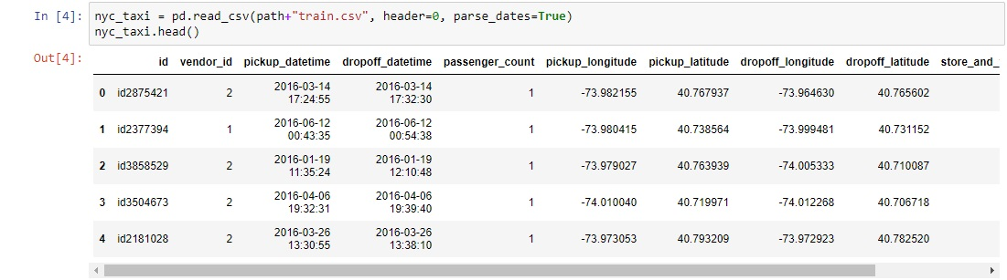
Data Preparation and EDA
First, begin with setting our path and importing required packages.
Now, Let’s read our dataset, we have some good amount of features in it.

Slide 10
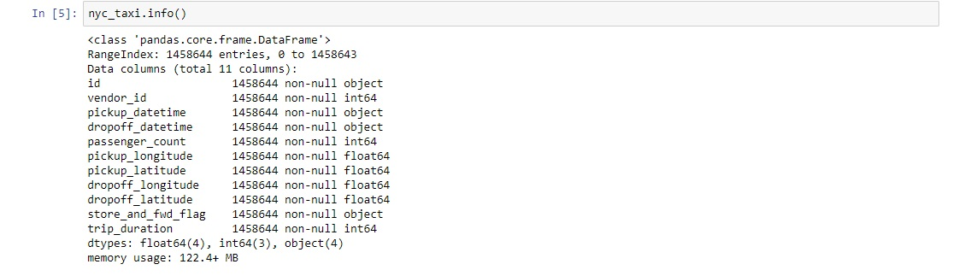
We have some features with “object” dtype and quite surprising to see that no Null Values.
Data fields:
id - a unique identifier for each trip
vendor_id - a code indicating the provider associated with the trip record
pickup_datetime - date and time when the meter was engaged
dropoff_datetime - date and time when the meter was disengaged
passenger_count - the number of passengers in the vehicle (driver entered value)
pickup_longitude - the longitude where the meter was engaged
pickup_latitude - the latitude where the meter was engaged
dropoff_longitude - the longitude where the meter was disengaged
dropoff_latitude - the latitude where the meter was disengaged
store_and_fwd_flag - This flag indicates whether the trip record was held in vehicle memory before sending to the vendor because the vehicle did not have a connection to the server - Y=store and forward; N=not a store and forward trip
trip_duration - duration of the trip in seconds

Slide 11
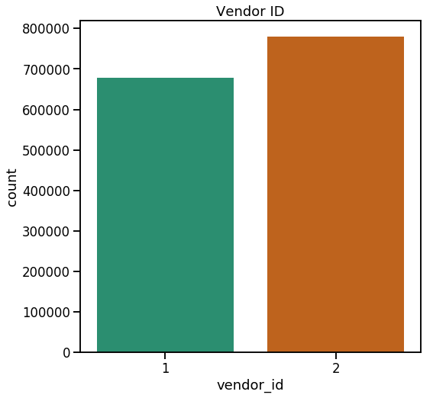
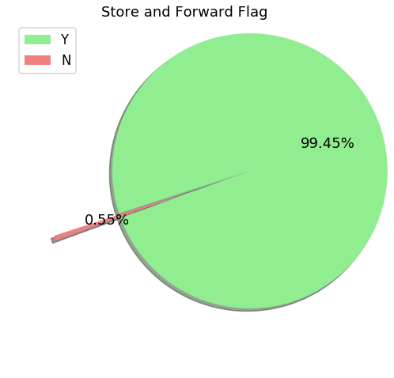
Now, we will perform basic EDA to get some insights into the data.
Vendor_ID stating the provider associated with trip, preferably 2 different taxi companies.
Analysis tells us that Second service provider has been most frequently opted by people over First service provider over the period of time.
We have almost all the trip records sent to the server.

Slide 12
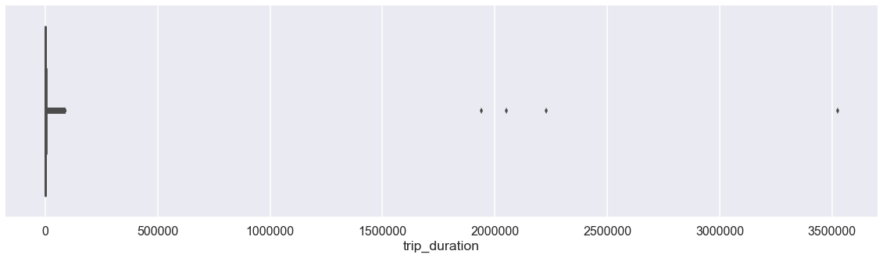
Trip Duration Viz.
Probably in this visualization we can clearly see some outliers (marked in Red) , their trips are lasting between 1900000 seconds (528 Hours) to somewhere around 3500000 (972 hours) seconds which is impossible in case of taxi trips , How can a taxi trip be that long ? It’s Quite suspicious. We’ll have to get rid of those Outliers or else it’ll affect our model’s performance.

Slide 13
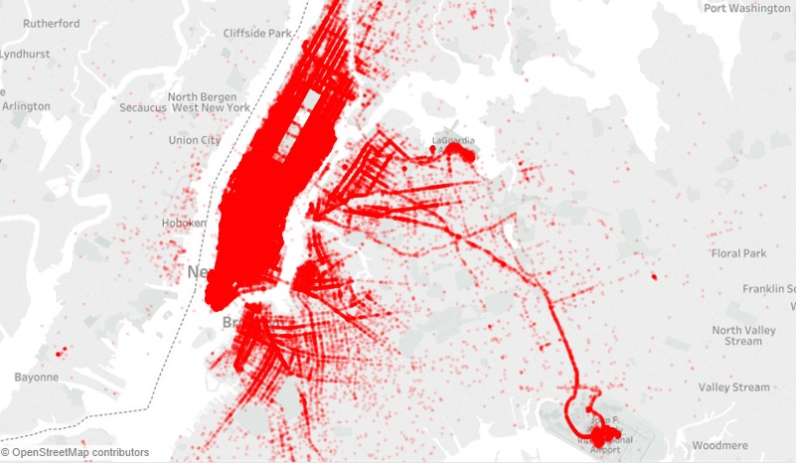
Pickup Points over the period of time, Apart from Manhattan we’ve some areas where we see most pickups, The LA Guardia Airport and JFK Airport.
Click here for Interactive Visualization

Slide 14
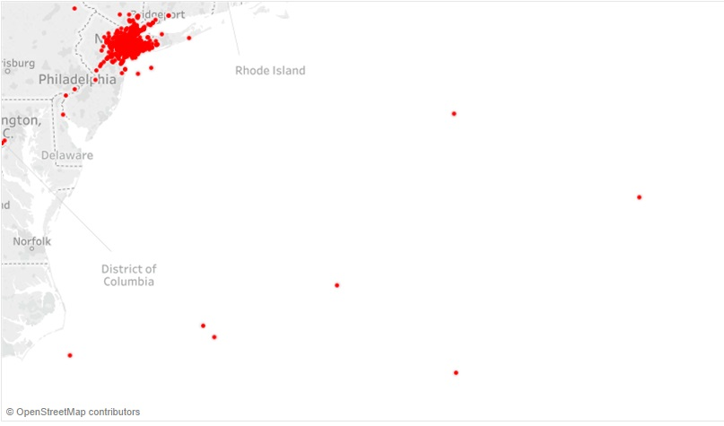
Some the pickup points reach far beyond the Land , probably in Sea which is kind of impossible, how can a taxi trip begin in Ocean ? Curiousity rises !

Slide 15
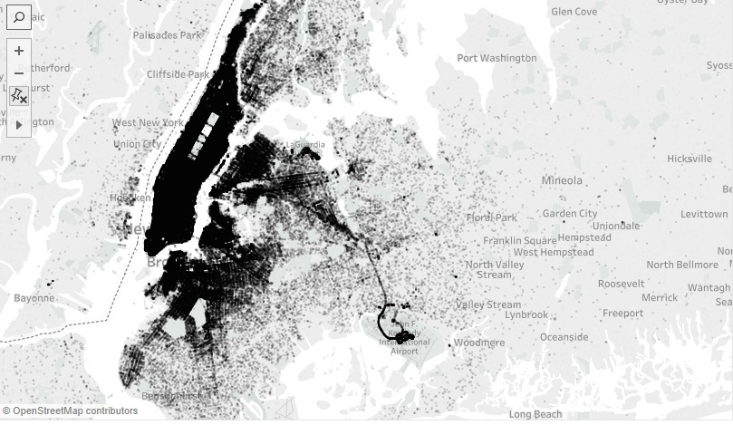
DropOff Points Visualization: Leaving Manhattan area, the place where we see more DropOffs are Airports (Marked in Red) , The LA Guardia Airport and JFK Airport.

Slide 16
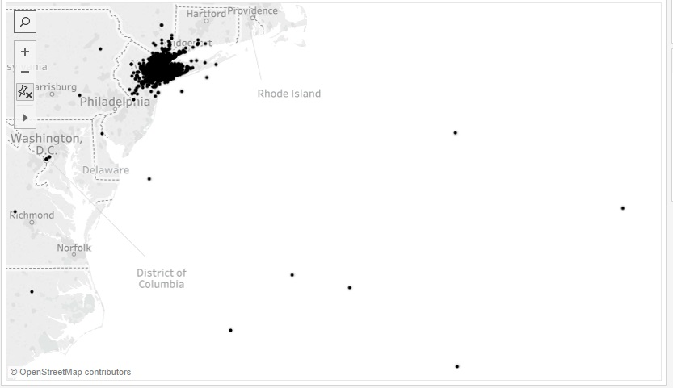
It’s evident from the above marked pickup and dropoff points which lead in the North Atlantic Sea, maybe these points responsible for 350000 seconds (972 Hours) trip duration, possibly an outliers.

Slide 17
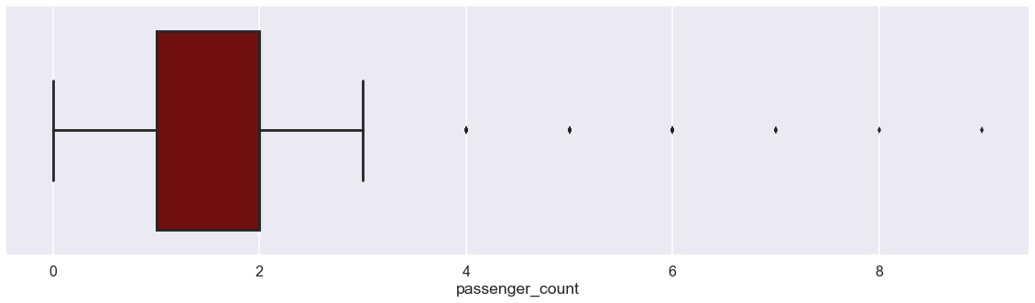
Most number of trips are done by single or double passengers.
But one thing is Interesting to observe, there exist trip with ZERO passengers, was that a free ride ? Or just a False data recorded ?

Slide 18
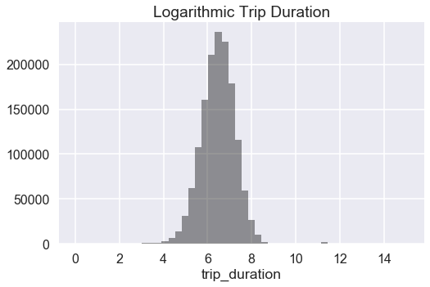
By Taking Logarithm of Trip duration we can Smoothen those.
Now, Log. Trip Duration is our Target to Predict.

Slide 19
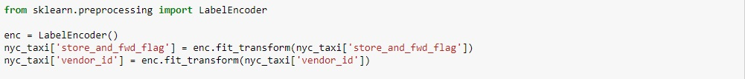
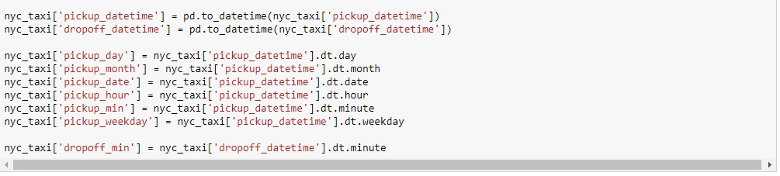
Label Encoding Categorical Variables ,i.e, “store_and_fwd_flag” and “vendor_id”. We can convert these features into “category” type by function called “astype(‘category’)” that will speed up the Computation. Since, my plan is to go with PCA for dimension reduction, I’m not going with that approach.
Feature Engineering
The Date and time columns in the Dataset has whole lot story to tell, we have to fetch them as separate columns. We do not have to fetch pickup and dropoff time both, as they may lead to strong positive correlation in the respective fetched features. Further we can use these columns for Analysis.

Slide 20
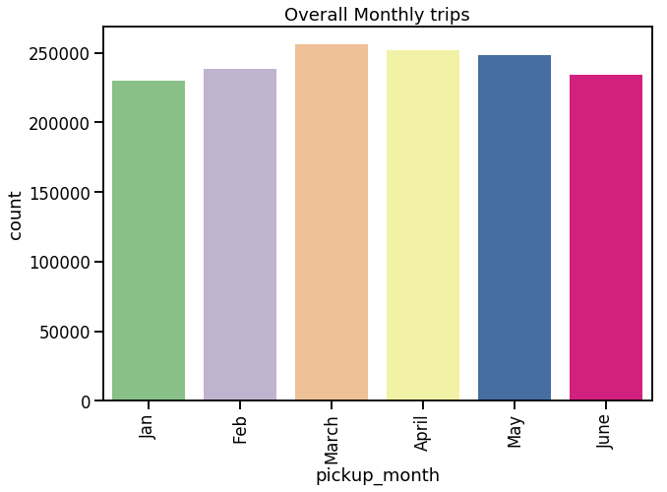
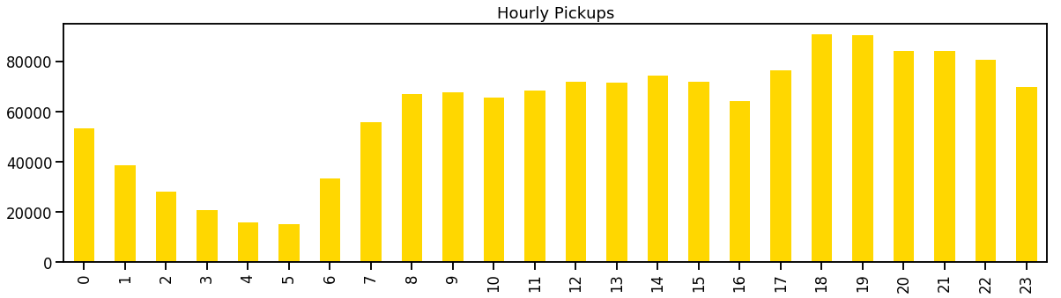
Number of trips in a particular month - March and April marking the highest. January being lowest maybe due to SnowFall.
In which hour we get to see maximum trips ? - Rush hours (5pm to 10pm)

Slide 21
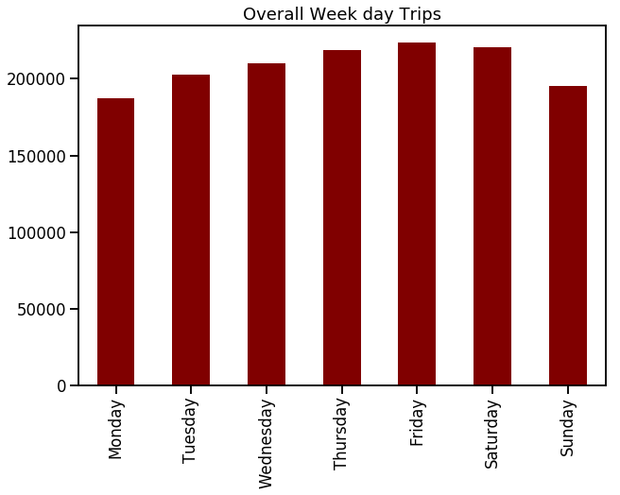
Observations says that Fridays and Saturdays are those days in a week when New Yorkers prefer to rome in city. GREAT !!

Slide 22
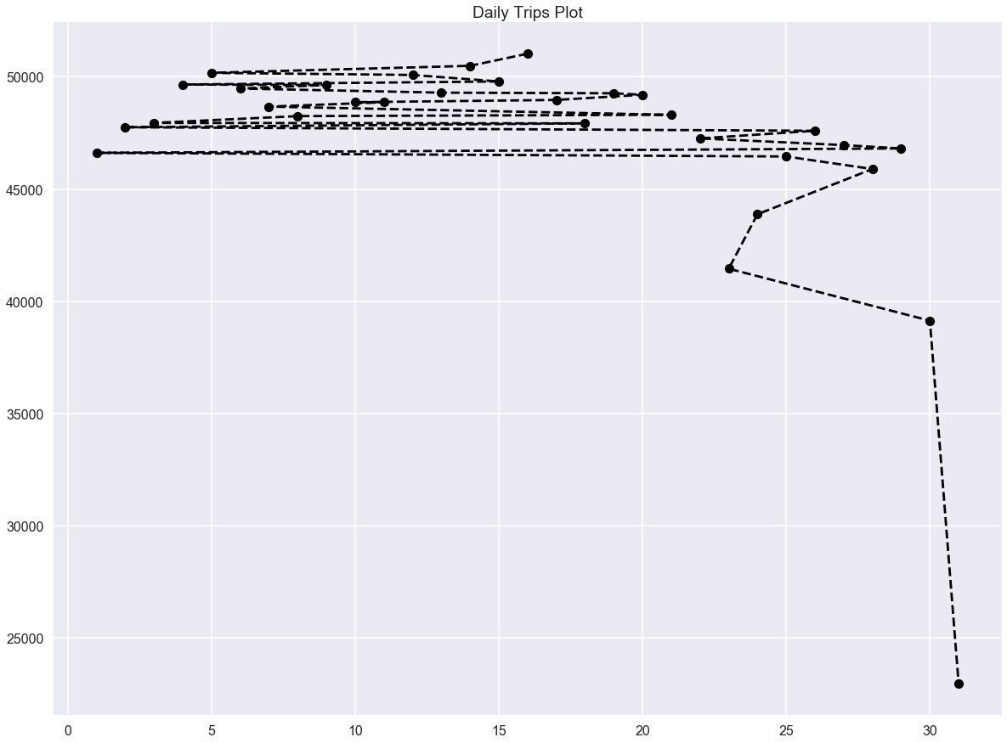
Seem like New Yorker’s do not prefer to get a Taxi on Month end’s , there is a significant drop in the Taxi trip count as month end’s approach.

Slide 23
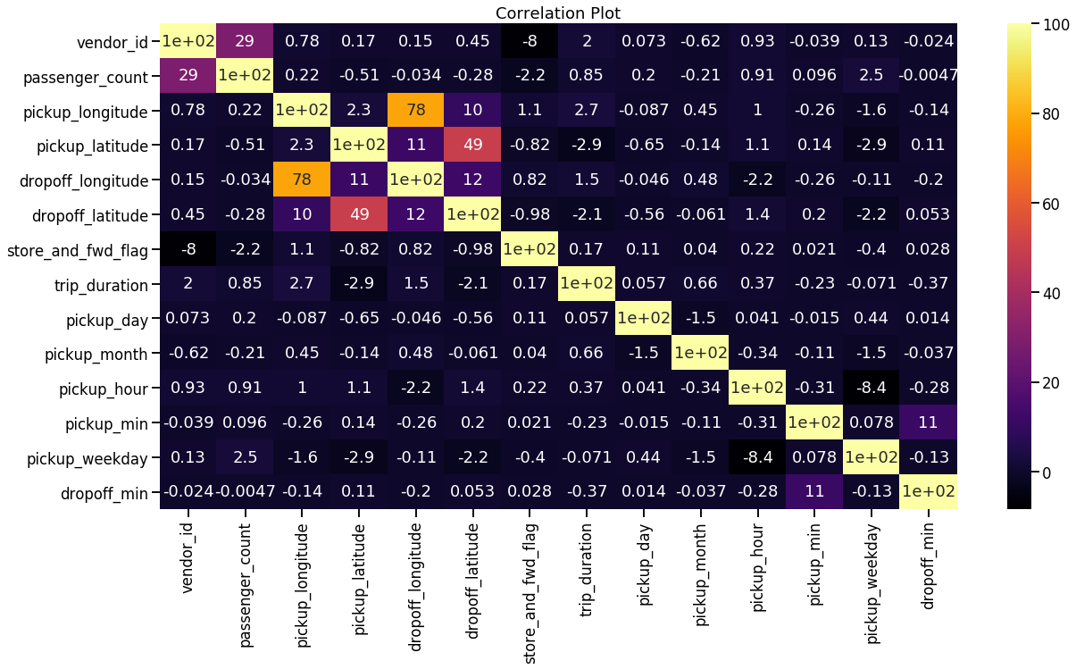
Correlation Heatmap

Slide 24
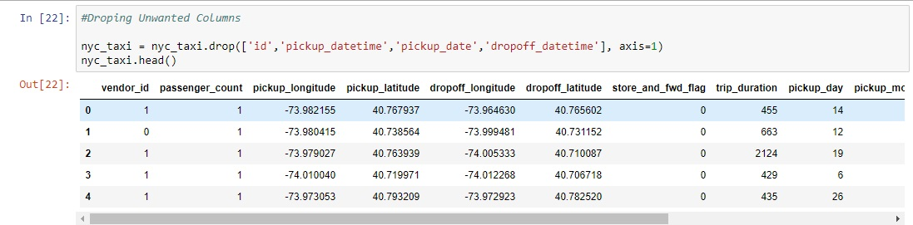
Let’s drop unwanted columns like ID, as it makes no sense and some other columns of which we have already fetched information separately.

Slide 25
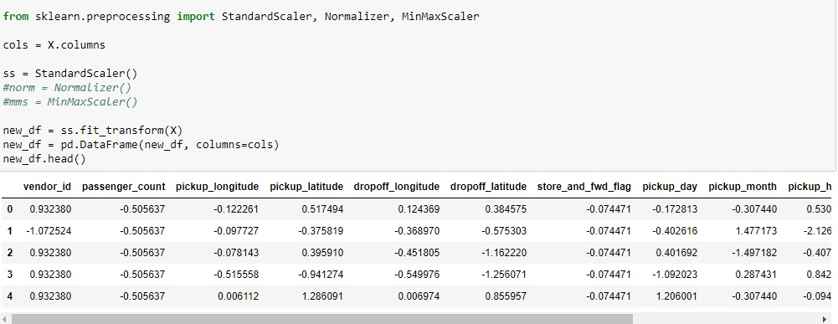
Normalizing the Dataset using Standard Scaling Technique.
Now, Why Standard Scaling ? Why not MinMax or Normalizer ?
It is because MinMax adjusts the value between 0’s and 1’s ,
which tend to work better for optimization techniques like Gradient descent and machine learning algorithms like KNN.
While, Normalizer uses distance measurement like Euclidean or Manhattan, so Normalizer tend to work better with KNN.

Slide 26
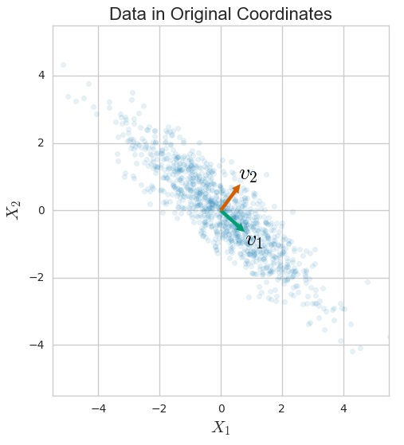
Principal Component Analysis
PCA is not used to Predict values. It is a Feature extraction Technique. By PCA we create new features from old (Original) Features but the new features will always be independent of each other.
From the Figure we can see the Variance (V1 and V2) explained by our Original data. PCA is known for Dimension reduction by Increasing Variance so that the Information is fairly retained with very minor loss.
When we have our data in higher dimension space , i.e., more features which can likely affect our model performance or consume too much computational resources that’s when PCA comes into picture.
Variance (V2)
Variance (V1)

Slide 27
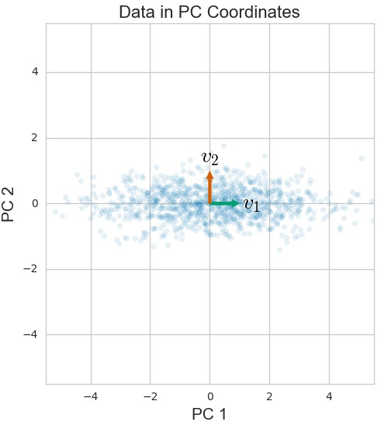
Principal Component Analysis
Now, we have to rotate our axes (X1 and X2) in such a way that they become Principal Components (PC1 and PC2) , we can clearly identify the Transformed data is explaining more Variance (V1).
Further we can consider the Transformed data as our independent Variable or Predictor.
Variance (V2)
Variance (V1)

Slide 28
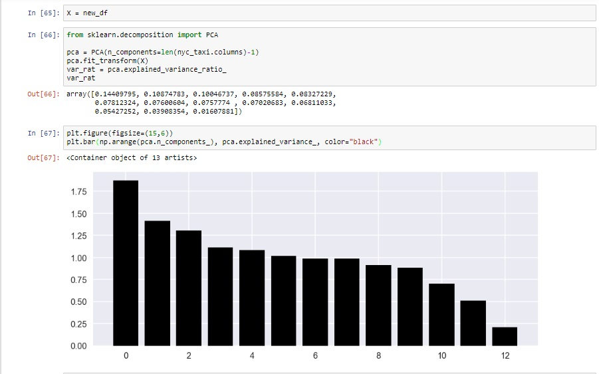
Now that we’re done, we have to pass our Scaled Dataframe in PCA model and observe the elbow plot to get better idea of explained variance. At 12th component our PCA model seems to go Flat without explaining much of a Variance.

Slide 29
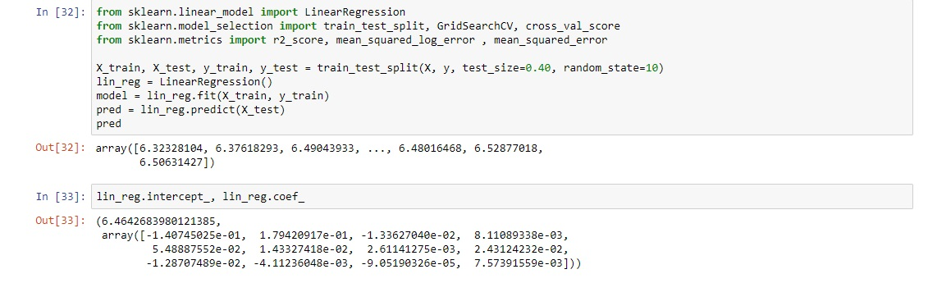
Linear Regression
Let’s pass the PCA Transformed data in our Machine Learning Regression Algorithms. To begin with , Linear Regression is a good approach, by splitting our Data into Training and Testing (30%). Our evaluation metric is RMSLE , not R-squared. We can also hyper tune our Parameters to minimize the loss (RMSLE). We will also calculate Null RMSLE , which we can set as a benchmark for our Models RMSLE.

Slide 30
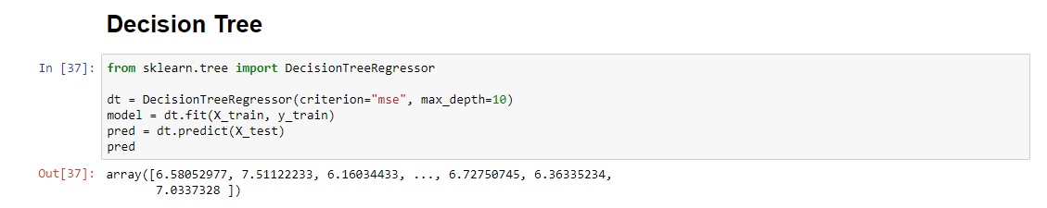
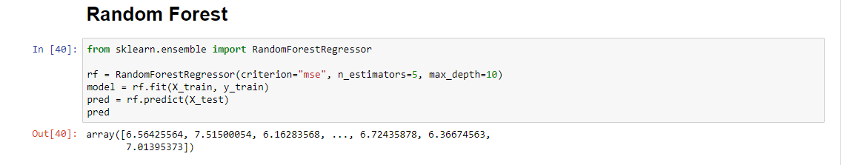
Decision Tree and Random Forest
We’ve to import Decision Tree Regressor and Random Forest Regressor and implement respective algorithms on our Data and evaluate results.

Slide 31

--- RMSLE Benchmark ---
Beat me if you can !!
Null RMSLE : 0.1146
We’ve Null RMSLE of 0.1146 which is benchmark for our Prediction model’s RMSLE. Our model’s RMSLE must be less than Null RMSLE.

Slide 32
Evaluation Results
Reference
R2-score: Usually must be between 0 and 1, towards 1 considered as good fit.
RMSLE: [Value] <= 0.1146 (Null RMSLE - A Benchmark to Achieve)
Algorithms | Training Score | Validation Score | Cross Validation Score | R2-Score | RMSLE
Linear Regression | 0.0424 | 0.0438 | -0.0485 | -23.10 | -
Decision Tree | 0.9258 | 0.9169 | 0.9137 | 0.9104 | 0.037
Random Forest | 0.9304 | 0.9245 | 0.9233 | 0.9177 | 0.035

Slide 33
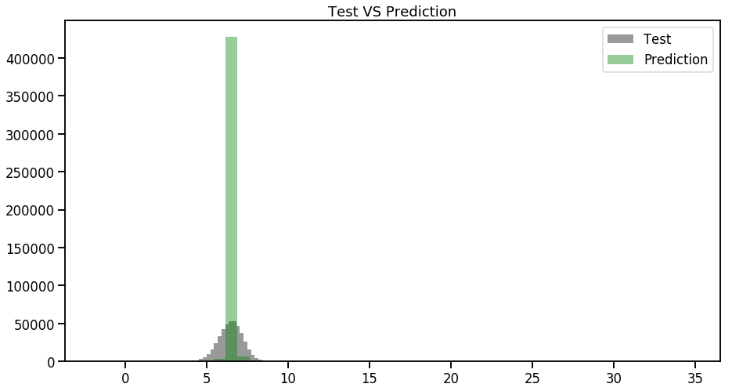
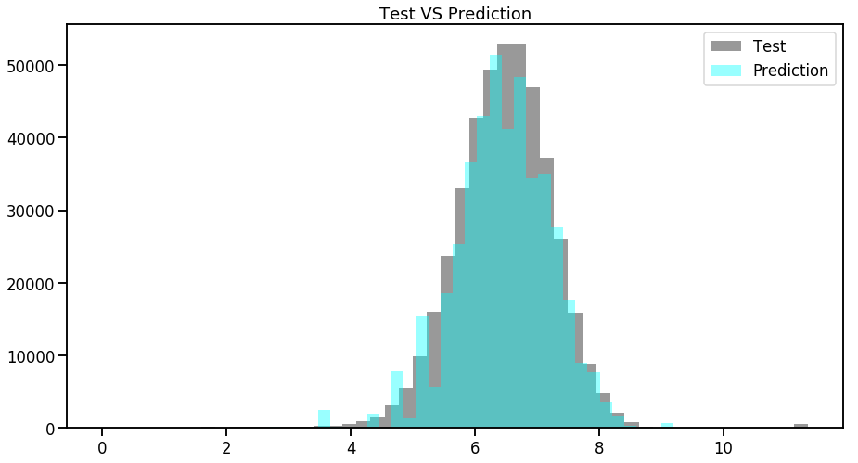
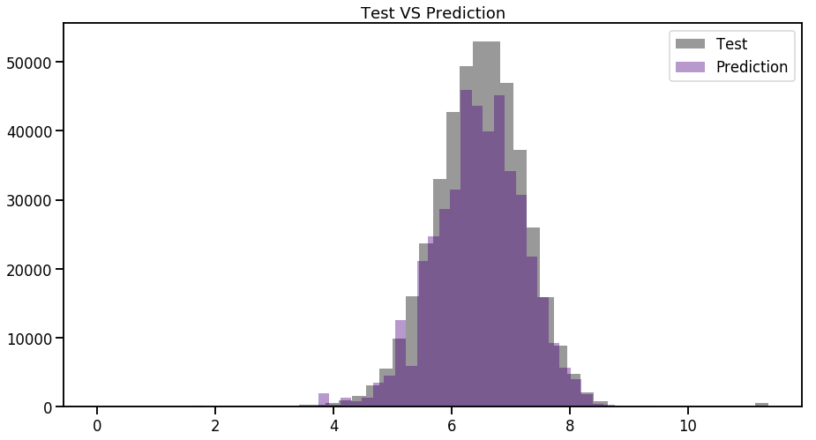
Linear Regression
Decision Tree
Visualizations show us How our model’s Predictions are close to Test Data. It is evident that Decision Tree and Random Forest are Performing well.
Random Forest

Slide 34
Another Approach…
Another approach we could go with is without PCA, just Standard Scaling Dataset and applying our Algorithms.
The approach can give us better idea of what works better for us.
This approach might take great amount of computational resources and time, it will be good if we can run this on Google’s Collaboratory, that will eliminate huge computational stress on our system as the program will be running on Cloud.

Slide 35
The “Without PCA” approach..
Remember our Null RMSLE: 0.1146
Algorithms | Training Score | Validation Score | Cross Validation Score | R2-Score | RMSLE
Linear Regression | 0.0434 | 0.0450 | -0.0487 | -22.45 | -
Decision Tree | 0.4643 | 0.4577 | 0.4575 | -0.161 | 0.087
Random Forest | 0.4760 | 0.4707 | 0.4726 | -0.176 | 0.087

Slide 36
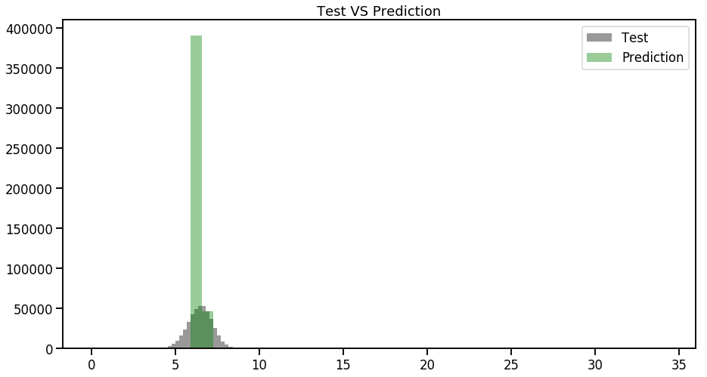
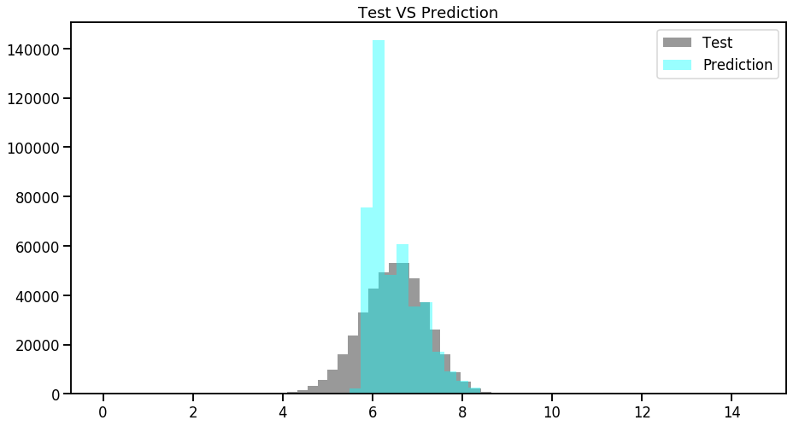
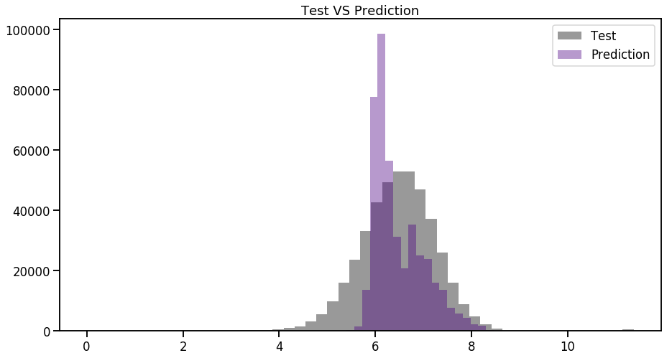
Linear Regression
Decision Tree
Test VS Prediction, How close they are ?
Random Forest

Slide 37
Recommended Approach
Apply Standard Scaling on the Dataset to Normalize the values.
Further, Apply PCA to reduce dimensions, as you’ll extract features from our
primary DateTime Feature. Those additional features might lead our model
to suffer from “Curse of dimensionality” and could drastically affect performance.
Pass the PCA Transformed data in our ML Regression Algorithms and Evaluate results.

Slide 38
Insights
Observed which taxi service provider is most Frequently used by New Yorkers.
Found out few trips which were going from 528 Hours to 972 Hours, possibly Outliers.
With the help of Tableau, we’re able to make good use of Geographical Data provided in the Dataset to figure prominent Locations of Taxi’s pickup / dropoff points.
Also, found out some Trips of which pickups / dropoff point ended up somewhere in North Atlantic Sea.
Passenger count Analysis showed us that there were few trips with Zero Passengers.
Monthly trip analysis gives us a insight of Month – March and April marking the highest number of Trips while January marking lowest, possibly due to Snowfall.
In a day, we could observe that 5pm to 10pm is the time when New Yorkers Rush too much.
Observations says that Friday’s and Saturday’s are those days in a week when New Yorkers prefer to get out of their home.

Slide 39
